Slide 1
HLSC3P96 Collector for ArcGIS
Sharon Janzen, MDGL

Slide 2
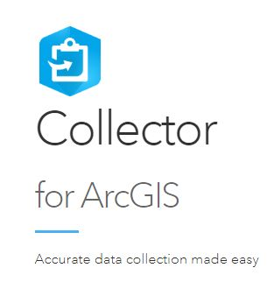
What is Collector for ArcGIS?
This mobile app is ideal for collecting data in the field then seamlessly integrating collected data to ArcGIS mapping software.

Slide 3
Accessing Collector
On your mobile device, download Collector for ArcGIS
You will be prompted to sign in using your ArcGIS Online credentials
Collector Tutorial and PowerPoint https://github.com/brockmdgl/HLSC3P96

Slide 4
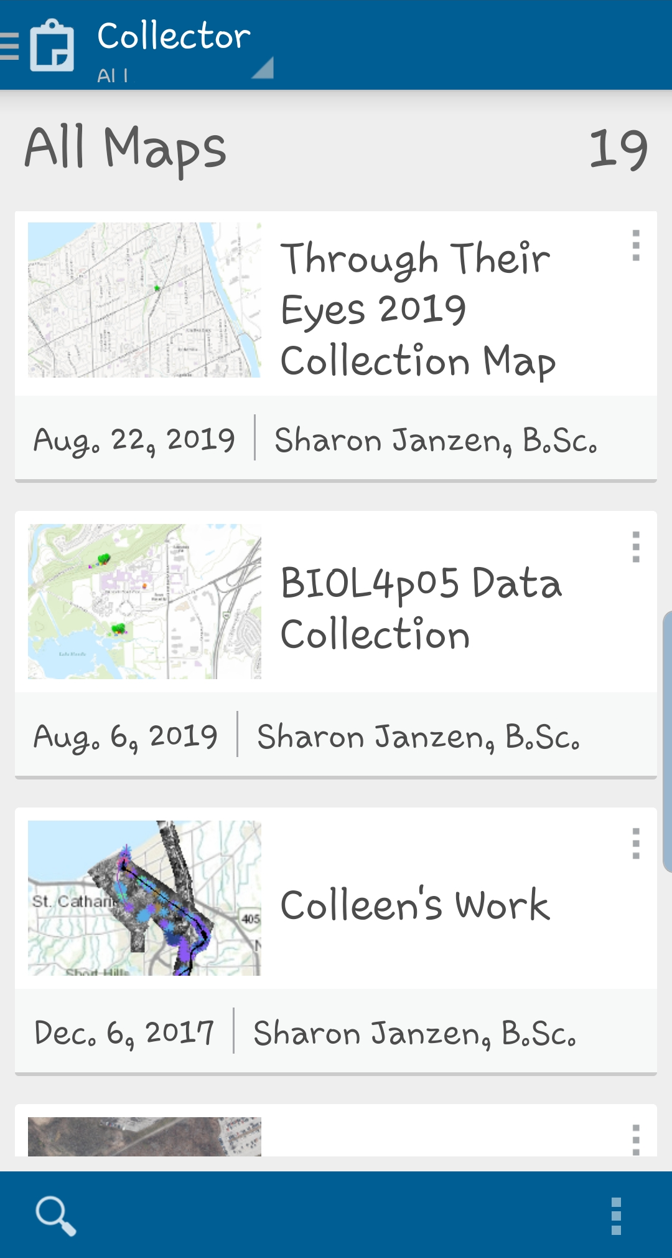

Slide 5
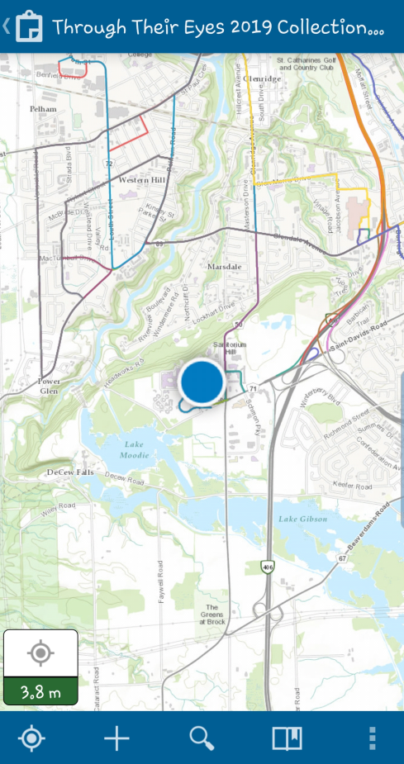
Custom Map
GPS location

Slide 6
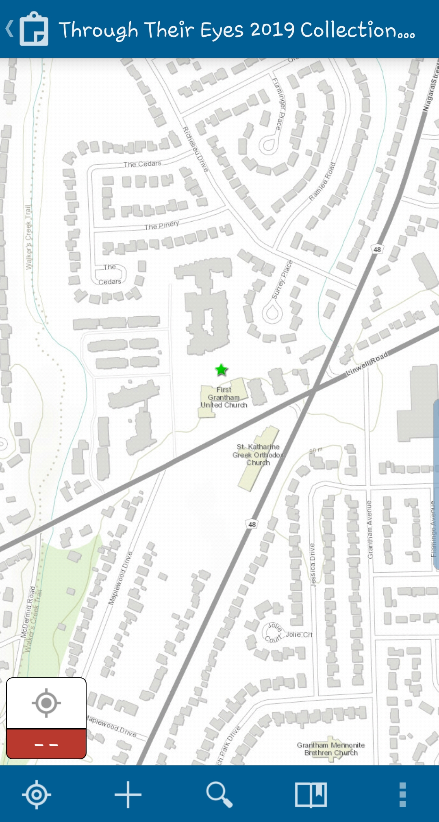
Zoom in/out by pinching
To add a feature,
Tap +

Slide 7
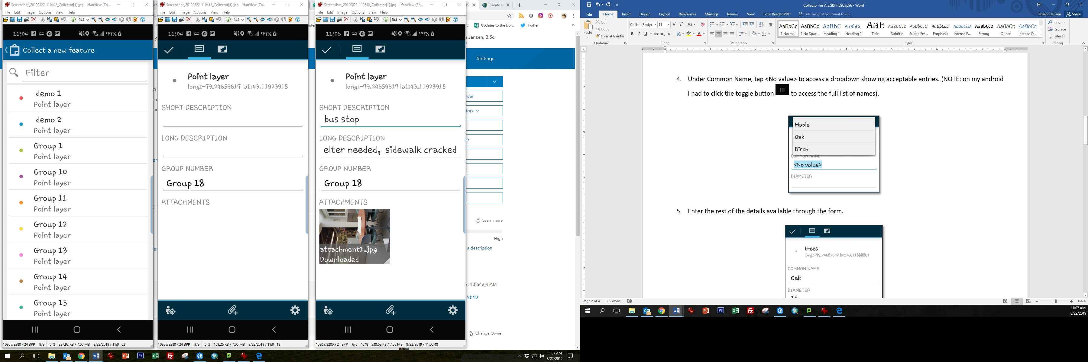
Select group number

Slide 8
Enter values
To capture a photo,
Click paperclip

Slide 9
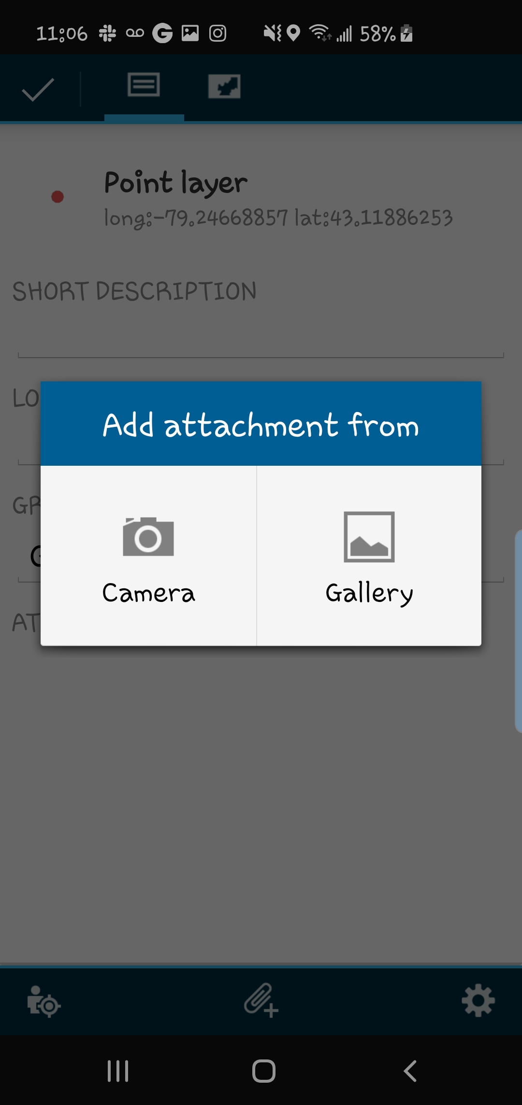
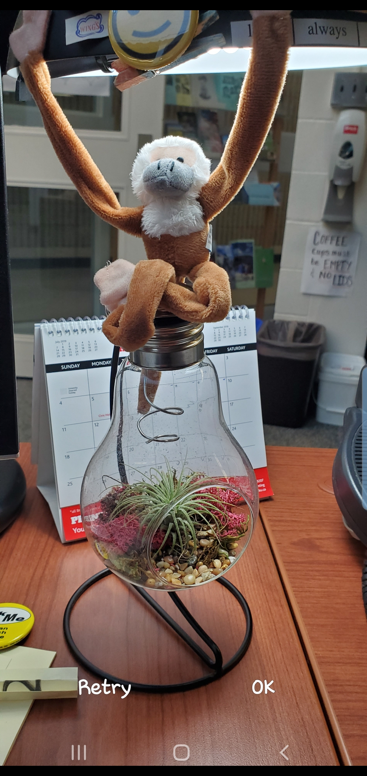
Tap Camera
Snap Photo,
Tap OK

Slide 10
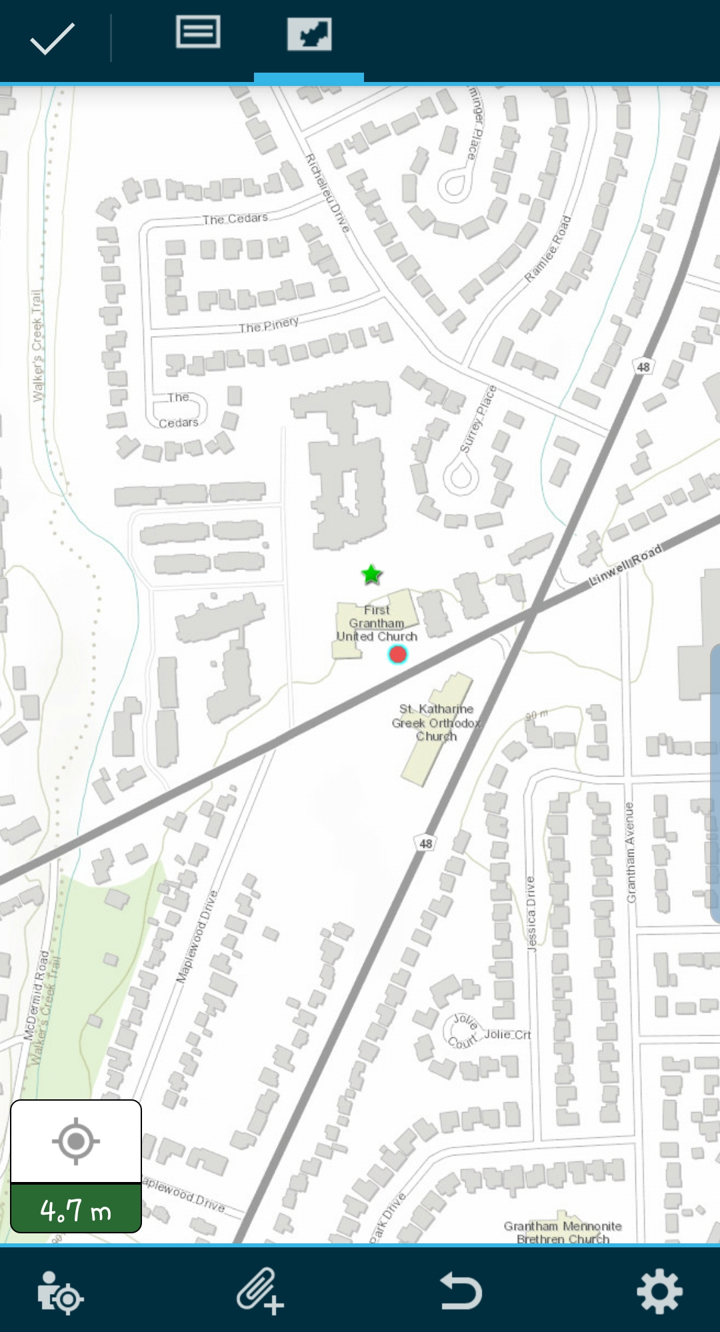
1. Tap map icon then
Zoom/pan or use GPS location
and tap to plot the point
2. Tap checkmark to finish

Slide 11
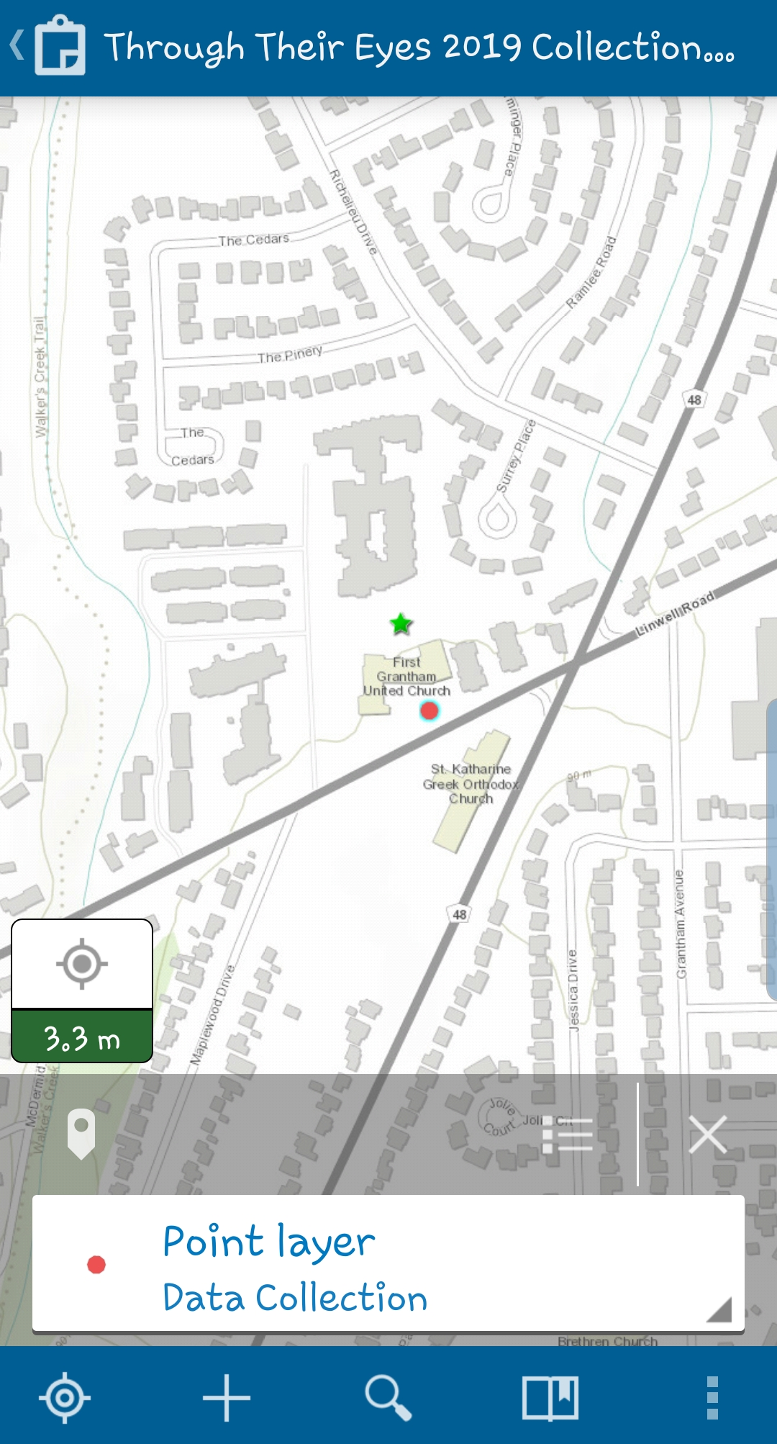
Tap here to see list of features
Tap here to edit/delete feature

Slide 12
Additional Reference Help
https://doc.arcgis.com/en/collector/iphone/help/quick-reference.htm
https://doc.arcgis.com/en/collector-classic/android/collect-data/quick-reference.htm
OR Google “Collector for ArcGIS quick reference”

